Slide 1
Line Angle Sensor Design

Slide 2
Outline
System Overview
Pivot Arm and Lower Pivot
Upper Pivot

Slide 3
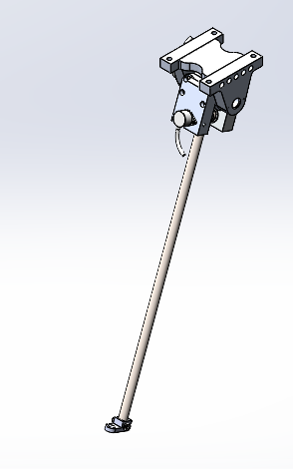
System Overview
2 Nested Axes
Renishaw RM22 13 bit encoders
Mass ~ 7.4 lbs

Slide 4
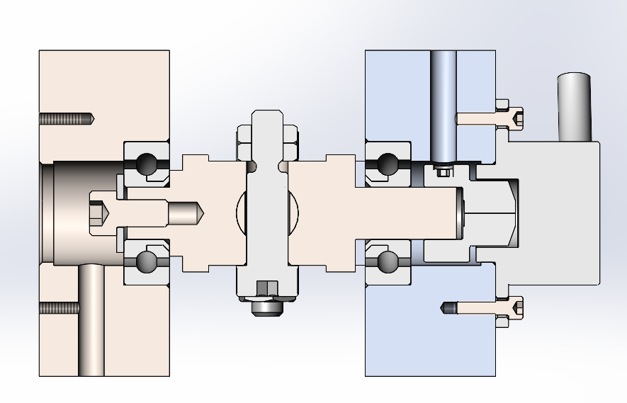
Lower Pivot and Arm
All 316 Construction
Bearings are Acetal raceway with 316 balls
Low strength and speed, but high corrosion resistance.
Potential improvement if transitioned to ceramic bearings, but high cost.
Bearings rated to 30 lbf static, 50 lbf dynamic.
Design preloads the pivot on arm against the passive side of the assembly.

Slide 5
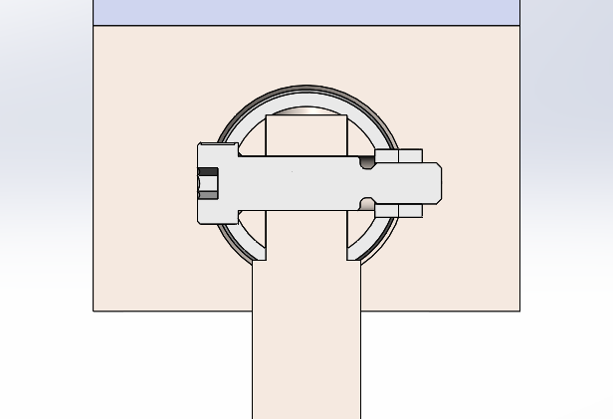
Lower Pivot and Arm
Tether Arm is attached to the pivot using a ¼” 316 shoulder bolt cross-drilled through the pivot and the arm.
Reliably and repeatably attach the arm and the pivot.
Similar method is used at the far end of the tether arm to attach the tether guide.

Slide 6
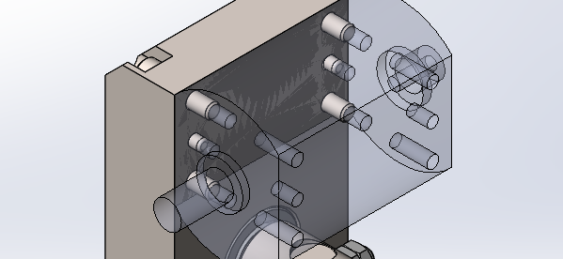
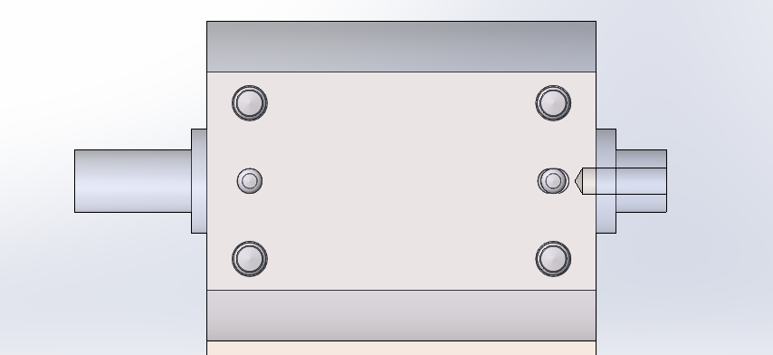
Lower Pivot Joint
Each half of the pivot joint is attached to the pivot for the upper axis.
Single peice manufactured from 316.
Doweled in place with 316 dowels.
Still deciding whether to dowel on both sides or one.
Will likely dowel on one side and let lower shaft align opposite side.

Slide 7
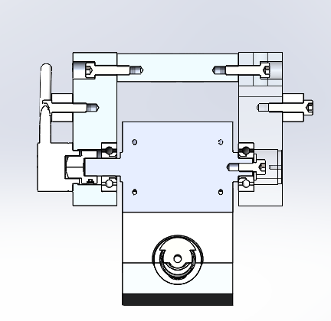
Upper Pivot
Same bearing layout as lower pivot arm.
Drilled and tapped holes for attaching an aluminum anode on each side.
Anode

Slide 8
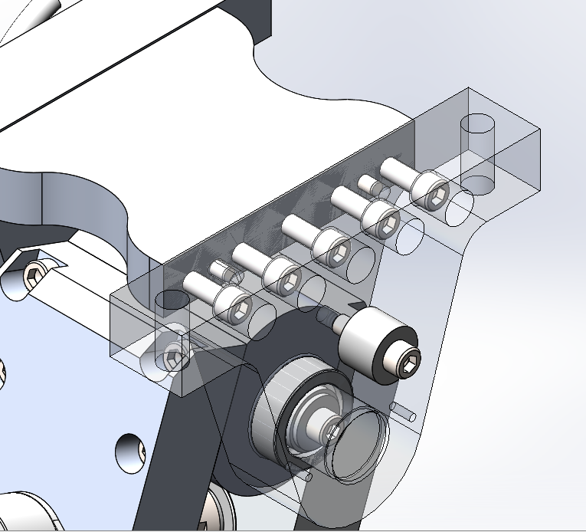
Upper Pivot
Each side of pivot plate is doweled into place.
4 Holes for attaching to cart or boom.
To be designed by Dillon Herbert for DOE or TBD for Manta Ray.
Anode

